Slide 1
TOP 5 State wise Loan Eligibility Analysis with OpenRefine & GCP
Sai Dinesh Kumar Reddy Addula
Vamshi Kodali
Mohana Srinitha Shaga

Slide 2
OBJECTIVE
To strategically establish a new bank branch in one of the top 5 GDP states in India, using data-driven insights based on:
The total number of loan applications received from each state.
The average income of applicants in these states.
The number of applicants with over 4 years of work experience.
The number of applicants who have resided at their current address for more than 2 years.
The total number of applicants with age greater than 25.

Slide 3
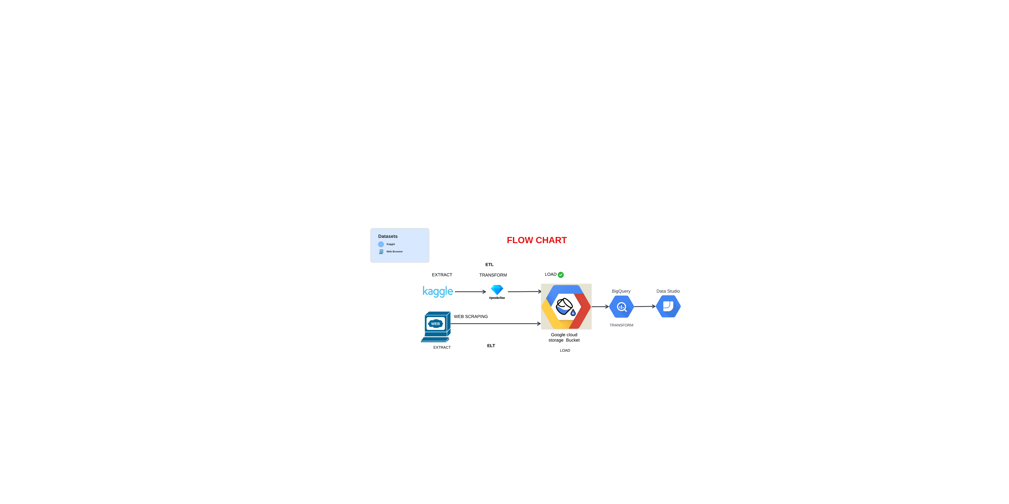

Slide 4
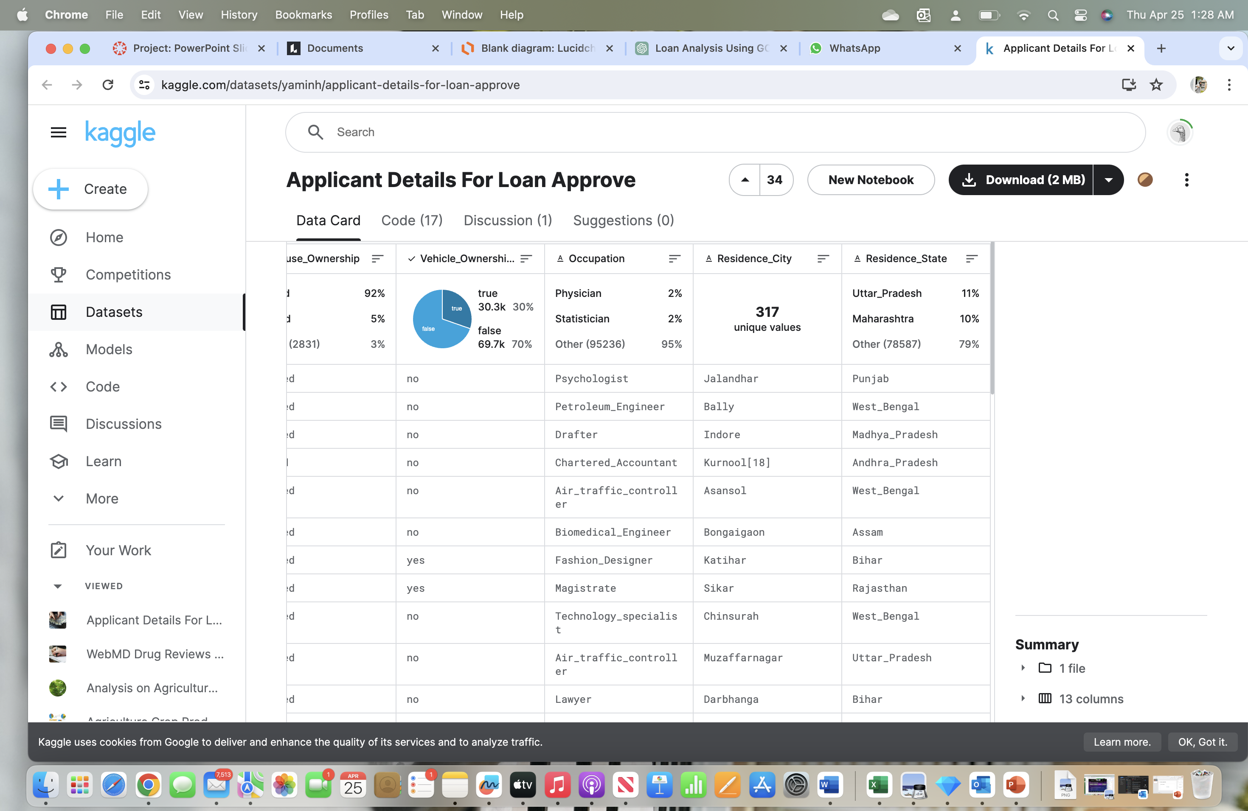
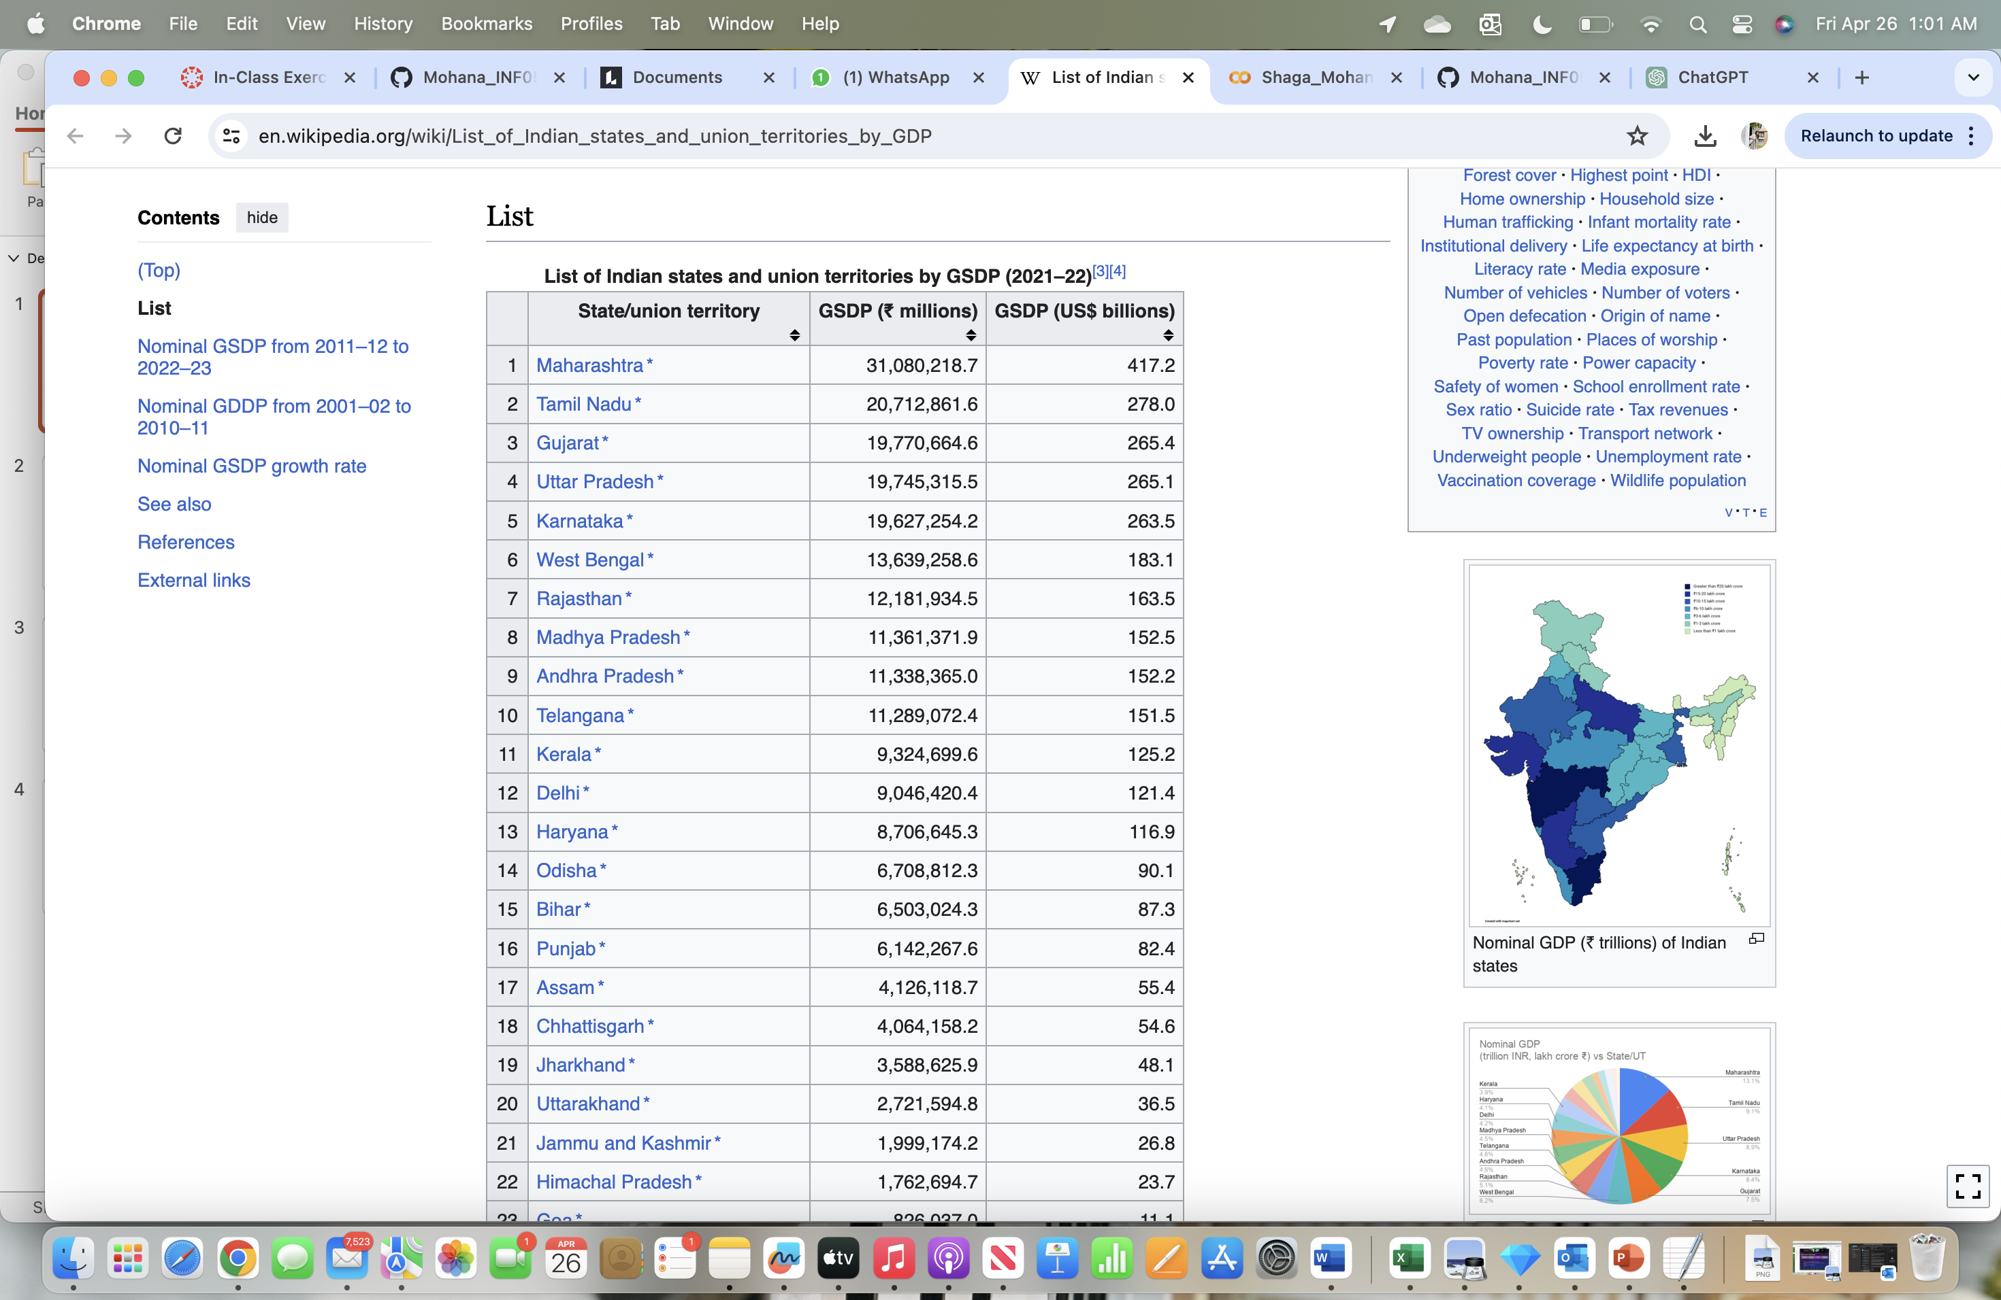
DATA COLLECTION
Kaggle Web

Slide 5
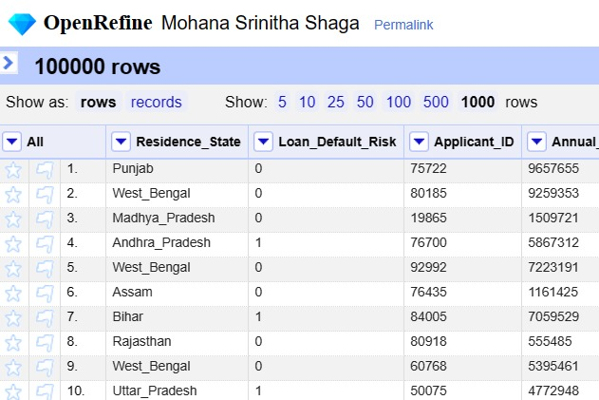
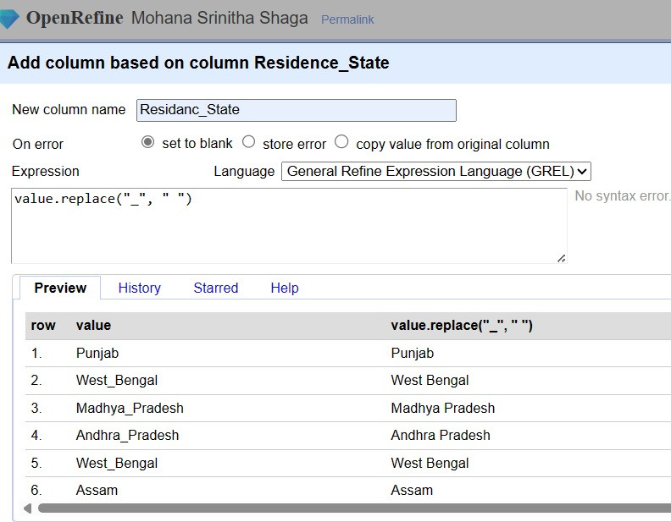
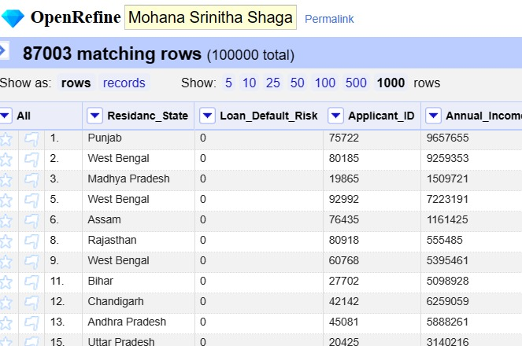
DATA CLEANING: Kaggle Data Processing

Slide 6
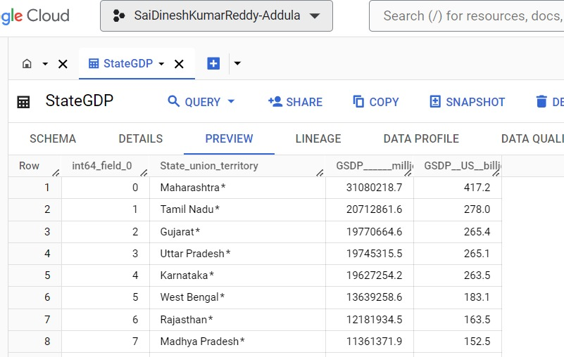
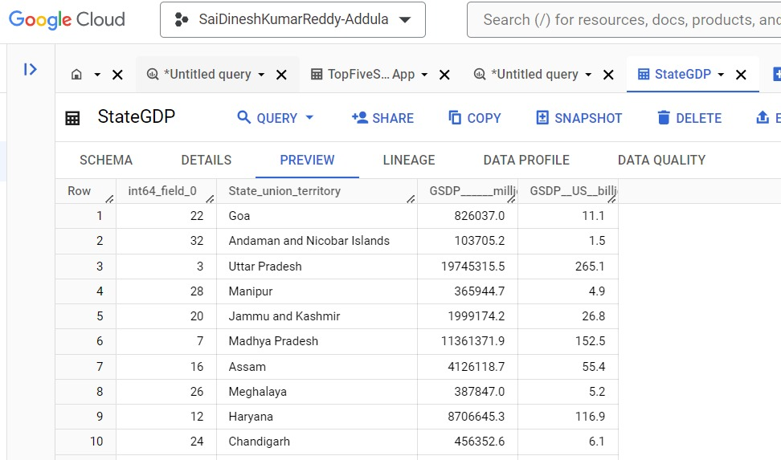
Web Data Processing
UPDATE ‘saidineshkumarreddy-addula.Group8Project.StateGDP’ SET State_union_territory = REPLACE(State_union_territory, ‘*’, ‘ ’) where State_union_territory LIKE ‘%’;

Slide 7
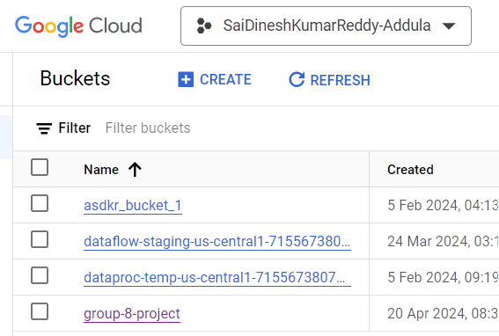

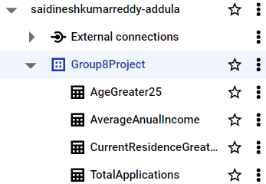

Types of storages used in gcp
Cloud Storage(object storage)
BigQuery(data warehouse)

Slide 8
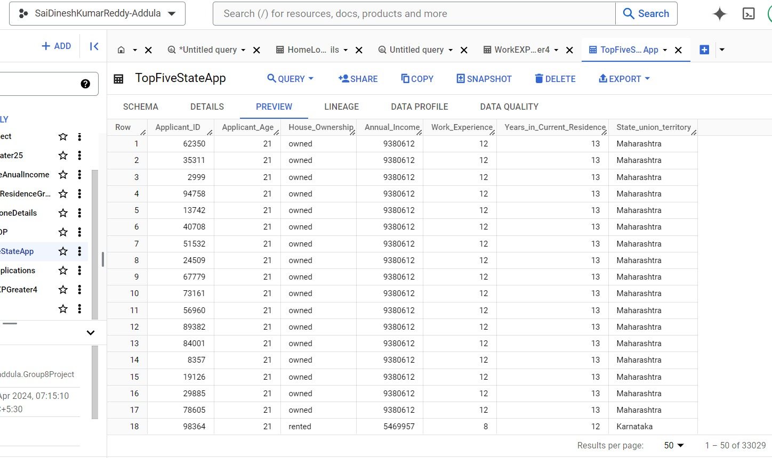
TOTAL APPLICATIONS
CREATE TABLE ‘saidineshkumarreddy_addula.Group8Project.TopFiveStateApp’ AS
SELECT
tb1.Applicant_ID,tb1.Applicant_Age,tb1.House_Ownership,
tb1.Annual_Income, tb1.Work_Experience,
tb1.Years_in_Current_Residence,
tb2.State_union_territory
FROM
(SELECT TRIM(State_union_territory) AS State_union_territory, GSDP_USbillions
FROM saidineshkumarreddy_addula.Group8Project.StateGDP
ORDER BY GSDP_USbillions DESC
LIMIT 5) AS tb2
INNER JOIN
saidineshkumarreddy_addula.Group8Project.HomeLoneDetails AS tb1
ON
tb1.Residence_State = tb2.State_union_territory;
The query generates a new table called TopFiveStateApp, which combines home loan applicant data from the five states with the greatest GSDP in your database. It combines the HomeLoneDetails table with a subquery of the top five states by GSDP, using residence state to state territory matching.

Slide 9
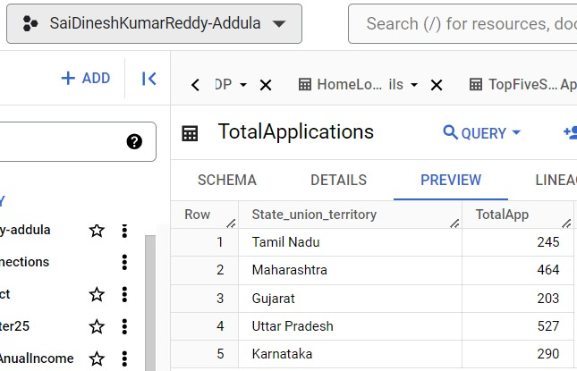
Top five state applications
CREATE TABLE saidineshkumarreddy_addula.Group8Project.TotalApplications AS SELECT State_union_territory, COUNT(*) AS TotalApp FROM saidineshkumarreddy_addula.Group8Project.TopFiveStateApp WHERE House_Ownership = 'owned' GROUP BY State_union_territory;
This generates a fresh table for storing the count of home loan applications with owned houses per state from the top five states based on GSDP.

Slide 10
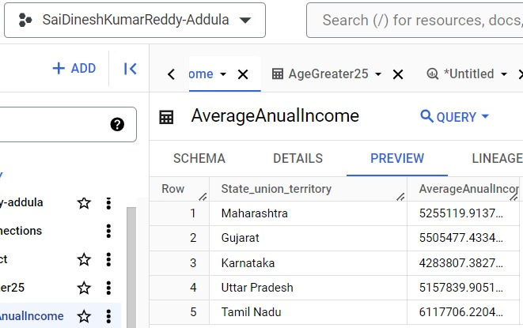
AVERAGE ANNUAL INCOME
CREATE TABLE saidineshkumarreddy_addula.Group8Project.AverageAnnualIncome AS
SELECT
State_union_territory,
AVG(Annual_Income) AS AvgAnnualIncome
FROM
saidineshkumarreddy_addula.Group8Project.TopFiveStateApp
WHERE
House_Ownership = 'owned'
GROUP BY
State_union_territory;
This generates a new table that stores the average yearly earnings of individuals who have applied for home loans and own homes in the top five states with the highest GDP.

Slide 11
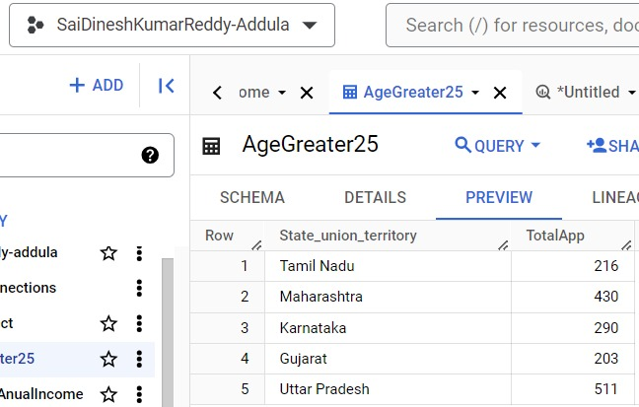
AGE GREATER THAN 25
CREATE TABLE saidineshkumarreddy_addula.Group8Project.AgeGreater25 AS
SELECT
State_union_territory,
COUNT(*) AS TotalApp
FROM
saidineshkumarreddy_addula.Group8Project.TopFiveStateApp
WHERE
House_Ownership = 'owned' AND Applicant_Age >= 25
GROUP BY
State_union_territory;
This generates a table displaying the number of home applicants aged 25 or above, categorized by state.

Slide 12
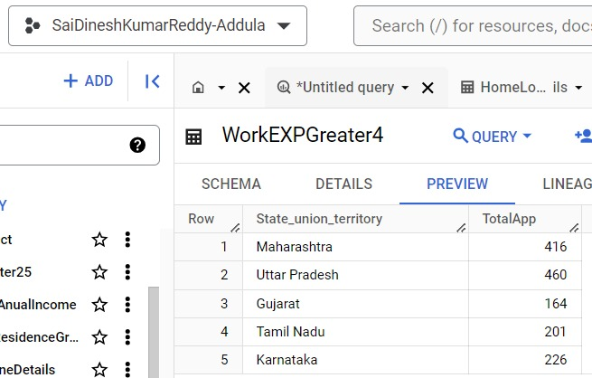
Work experience greater than 4
CREATE TABLE saidineshkumarreddy_addula.Group8Project.WorkEXPGreater4 AS
SELECT
State_union_territory,
COUNT(*) AS TotalApp
FROM
saidineshkumarreddy_addula.Group8Project.TopFiveStateApp
WHERE
House_Ownership = 'owned'
AND Work_Experience >= 4
GROUP BY
State_union_territory;
The query creates a new table listing each state or territory and the count of loan applications where the applicant owns a home and has 4 or more years of work experience.

Slide 13
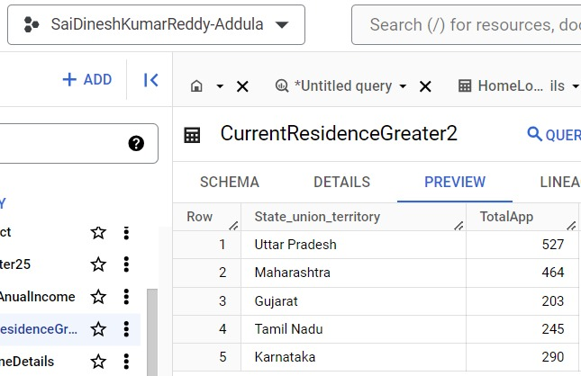
Current residence greater than 2
CREATE TABLE saidineshkumarreddy_addula.Group8Project.CurrentResidenceGreater2 AS
SELECT
State_union_territory,
COUNT(*) AS TotalApp
FROM
saidineshkumarreddy_addula.Group8Project.TopFiveStateApp
WHERE
House_Ownership = 'owned'
AND Years_in_Current_Residence >= 4
GROUP BY
State_union_territory;
The query generates a fresh table that displays the states or territories alongside the number of loan applications where the applicant possesses a home and has accumulated 4 or more years of work experience.

Slide 14

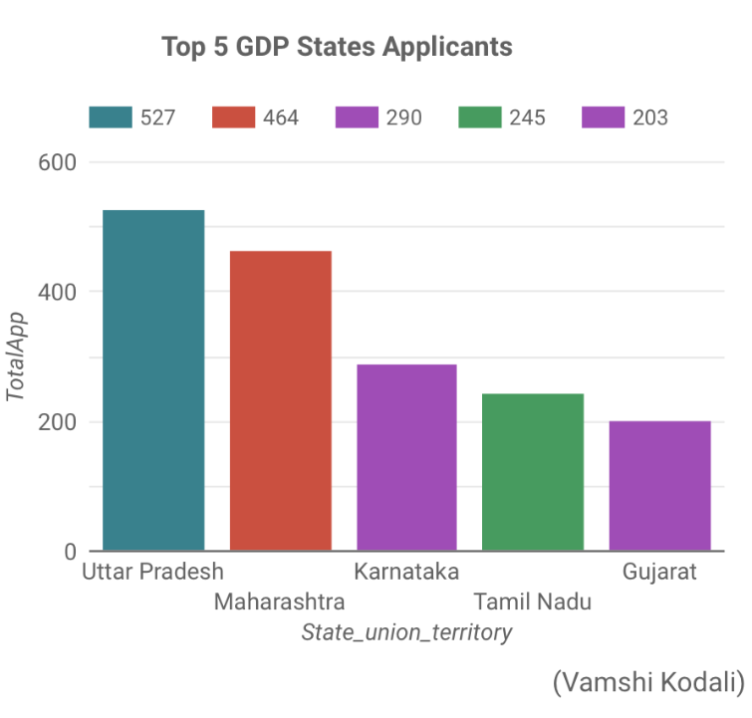
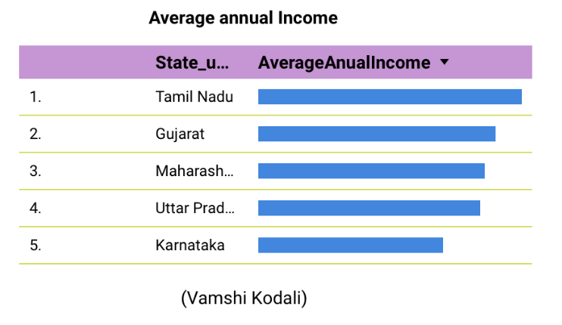
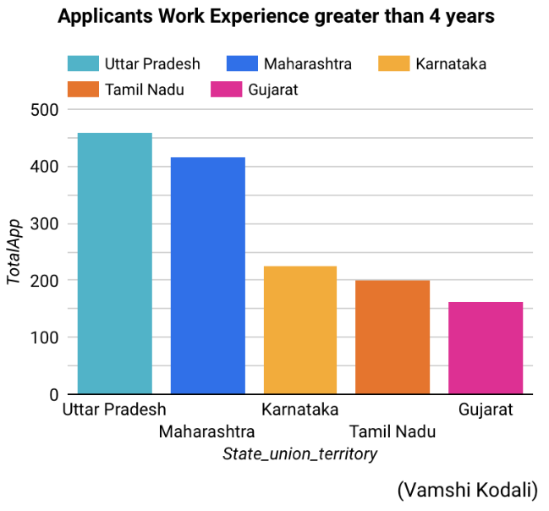
Visualization
The bar chart displays the number of applications from India's top 5 GDP states. Uttar Pradesh leads with 527 applications, followed by Gujarat (203), Tamil Nadu (245), Maharashtra (464), and Karnataka (464). The y-axis likely represents 'Total Applicants,' with state names on the x-axis.
The table displays the average annual income of the top five states in India: Tamil Nadu, Gujarat, Maharashtra, Uttar Pradesh, and Karnataka. Tamil Nadu has the highest income, while Karnataka has the lowest, with bars arranged in descending order accordingly.
The chart illustrates applicants with over four years of experience from five Indian states. Uttar Pradesh leads with about 450, Maharashtra closely follows. Tamil Nadu and Karnataka have around 250-300 each, while Gujarat has about 150 applicants.

Slide 15
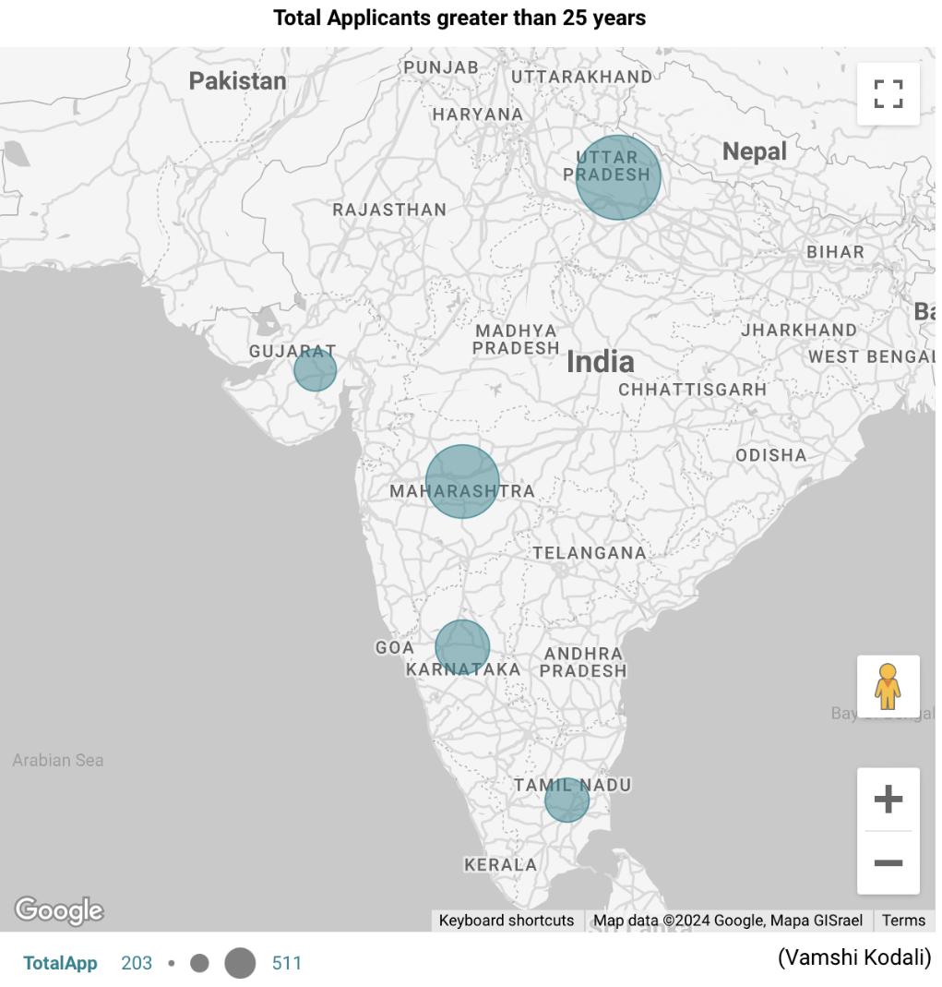
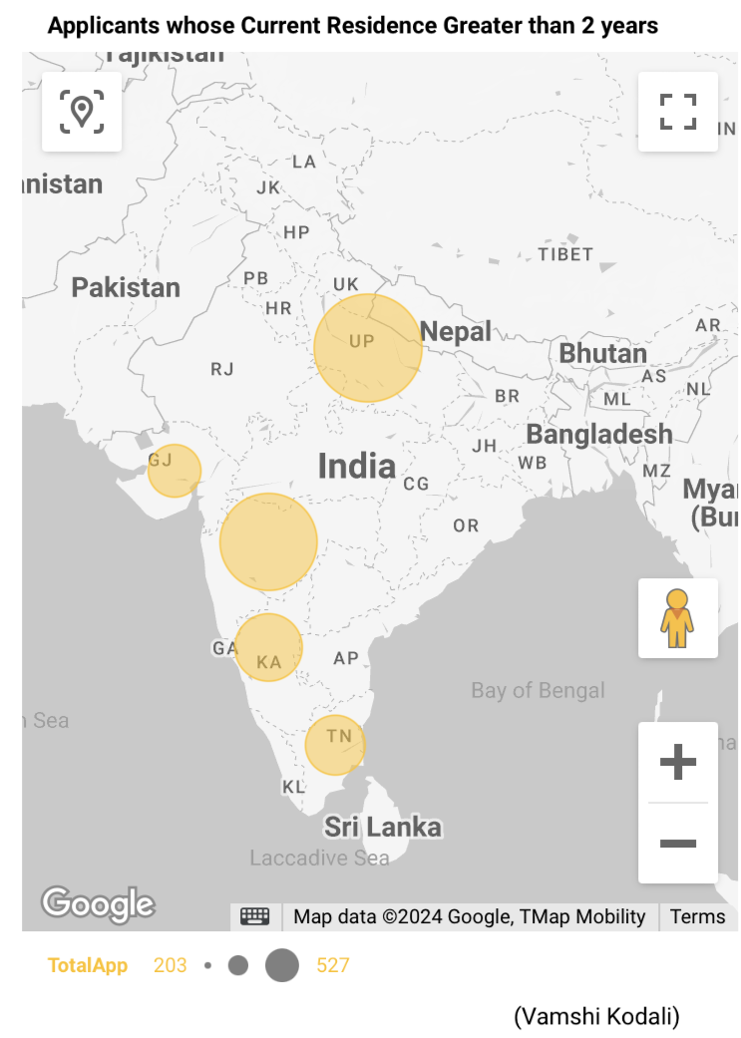
The map displays Indian applicants who've lived in the same place for over 2 years. Larger circles over Gujarat (GJ), Uttar Pradesh (UP), Karnataka (KA), and Tamil Nadu (TN) represent more applicants. After UP, Karnataka, Tamil Nadu, and Gujarat have the most applications.
The map of India shows circles over Gujarat, Maharashtra, Uttar Pradesh, Karnataka, and Tamil Nadu, representing the proportion of applicants over 25. The blue circles indicating relative numbers of applicants in each state.

Slide 16
Reference:
https://www.kaggle.com/datasets/yaminh/applicant-details-for-loan-approve
https://en.wikipedia.org/wiki/List_of_Indian_states_and_union_territories_by_GDP

